Slide 1
A System Design for Interacting with Linked Data in the Manufacturing Domain
Bachelor’s Thesis - Final Presentation
Matthias Schedel - February 14, 2018

Slide 2
Structure
Motivation - Challenges in Smart Manufacturing
Related Work - Interaction systems and user evaluations
Design - Dataflow chain on the shop floor
Implementation - Visualization apps and extensible data interfaces
Evaluation – PCB maintenance scenario
Conclusion - Future outlook of the interaction system

Slide 3
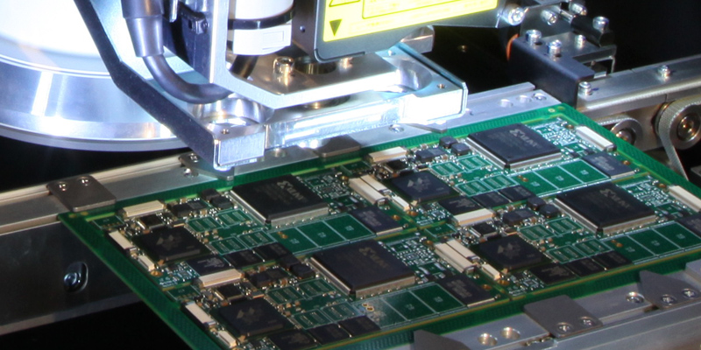
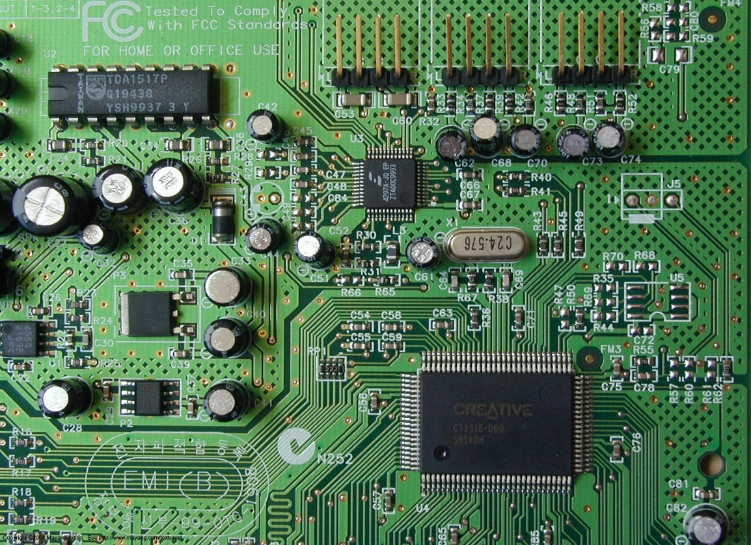
Background and Challenges
Background
Monitoring and maintenance of PCB production depends on sensor data
Challenges
Creation of data islands
Proprietary formats
Hierarchical data aggregation
→ Relationships between actors often not available
Data readability low
Tools require expert knowledge
→ Hard to understand cause and effect of complex events
AOI device scans PCB during production
y-shift
x-shift
https://s-media-cache-ak0.pinimg.com/originals/1b/cc/6f/1bcc6f3a4ebb4564e2dfbd6778c6c46e.jpg

Slide 4
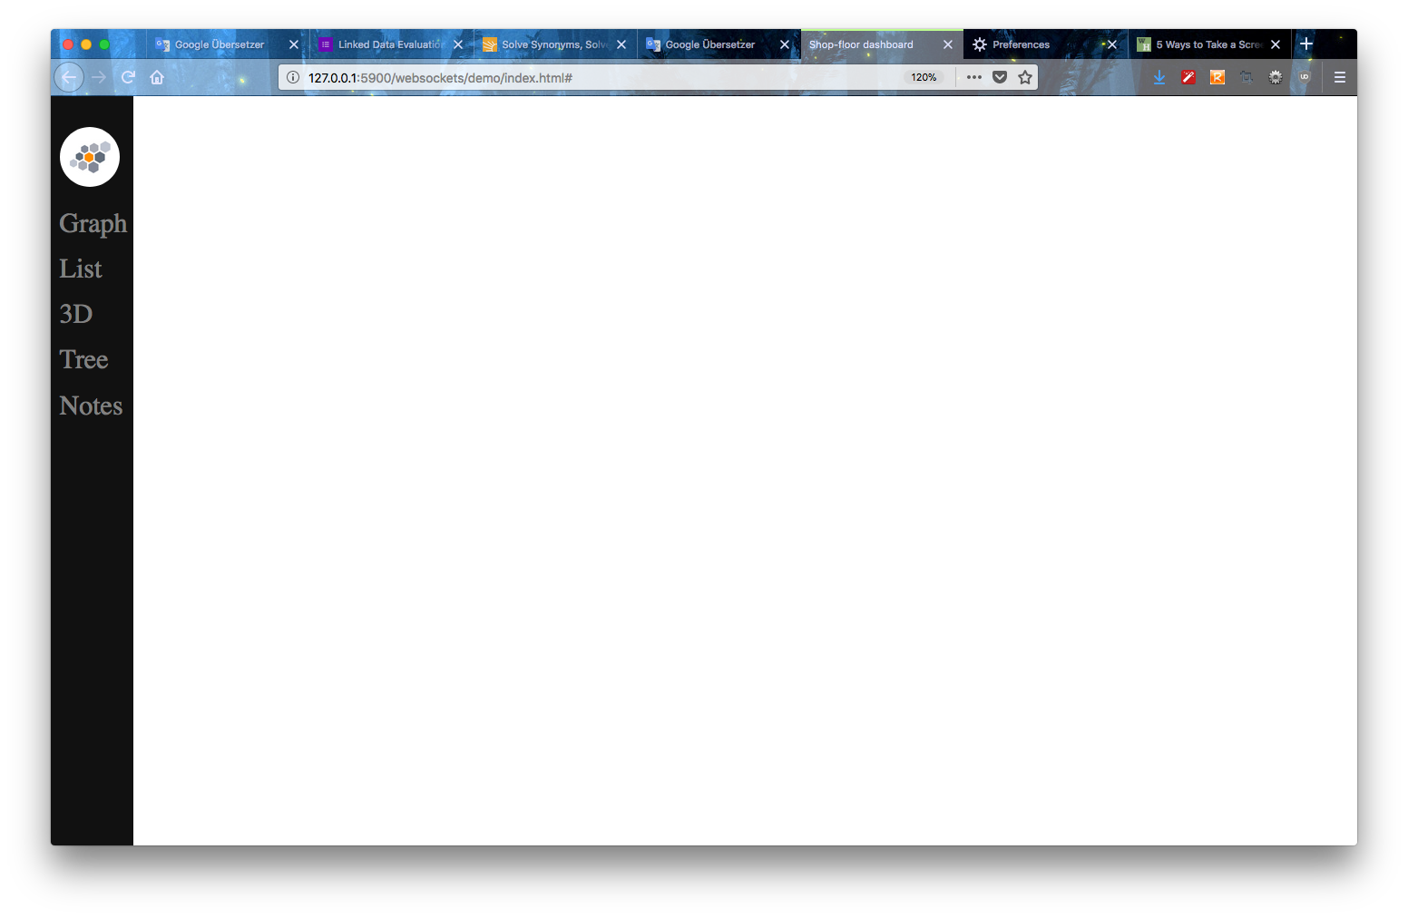
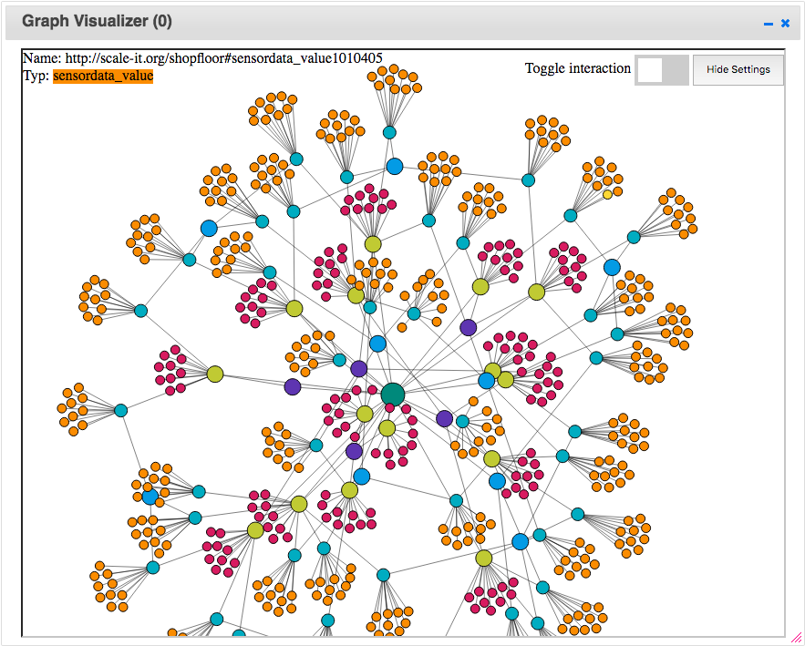
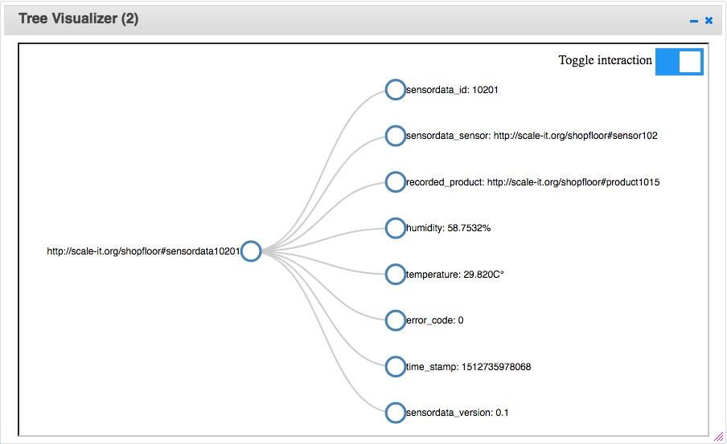
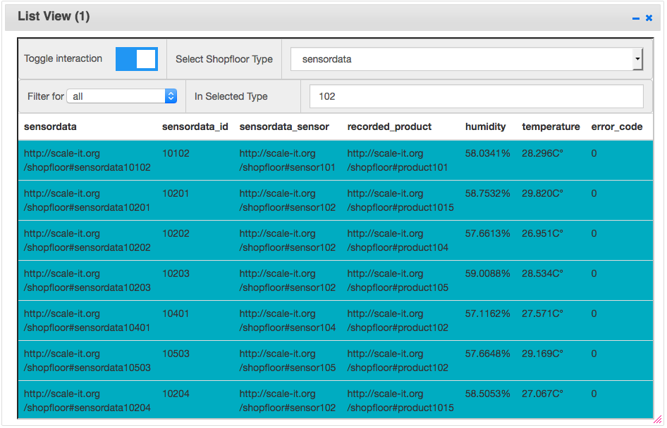

Solution – Shop Floor System
Prevent creation of data islands
→ Raw sensor data acquisition and Linked Data generation
Linked Data adapters
Extensible data interfaces
Receive raw sensor data
Parse sensor data to JSON
Generate
JSON-LD
Store JSON-LD in RDF store
Improve readability and understanding of relationships
→ Linked Data visualization
Linked Data visualization apps
User Contexts allow interactions between visualization apps
Notes:
System consists of three parts…
Linked Data adapters = Ext. Data interfaces oder ähnlich?

Slide 5
Related Work
Provenance Aware Linked Sensor Data - Blizzard detection system
→ Raw sensor data acquisition and Linked Data generation
App Orchestration - Mobile maintenance of a chemical plant
→ Combine apps for complex workflows
Ontology based visual querying - Turbine monitoring and maintenance
→ Evaluation tasks
Shop floor scenario
Mobile maintenance app
Ontology based visual querying - Evaluation tasks
Matthias Schedel - Shop-Floor Linked Data Graph
Notes:
iLD = interactive Linked Data applications

Slide 6
Design – Dataflow Chain on the Shop Floor
Raw sensor data acquisition and Linked Data generation
Linked Data storage and provision
Linked Data querying and visualization
Product line
Product
Sensor
Shop floor system
scans
raw data
Linked Data visualization
Product
User
Shop floor system:
Linked Data gener-ation
Linked Data storage
Linked Data Visual-ization
Linked Data
Linked Data
Shop floor dataflow chain

Slide 7



Implementation – System architecture
Deployment - Docker
Linked Data Store - Fuseki
Linked Data queries - SPARQL
we
Web interface
Vis. App
Comm. Center
App
Dash-board
App
Dash-board
App
Semantic App
Storage App
Sensor
Existing Linked Data
Shop floor system app architecture
Notes:
Zu überladen? Graiiken weglassen?

Slide 8
Example Use Case – Find a sensor recording of the product with id 109
Notes:
We start with empty dashboard-
Steps performed in gif demo:
Open List view app
Open Graph view app
Select type in list view
Search for number (sensor)
Enable toggle in graph view
Click in graph view
Open tree
Enable toogle
Click in graph view on sensor data

Slide 9
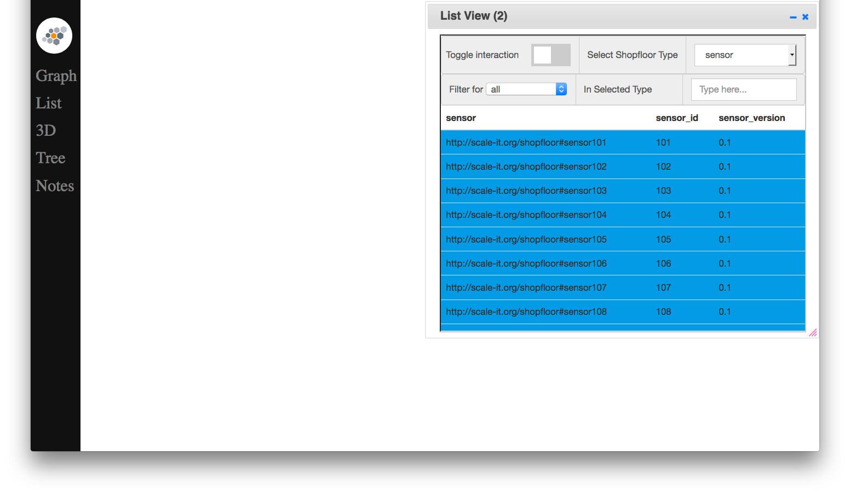
1. Open List View App
Notes:
We click List to open Listview

Slide 10
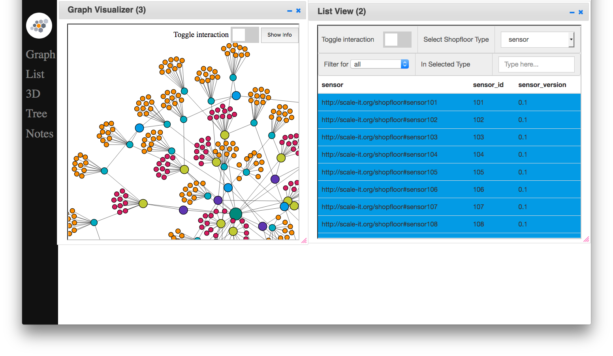
2. Open Graph View App

Slide 11
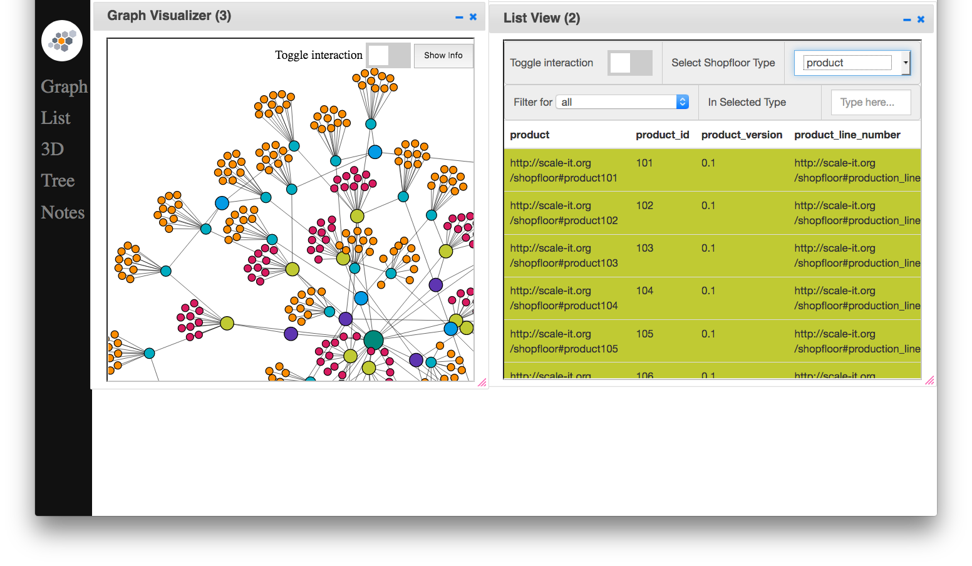
3. Select Entity Type in List View App

Slide 12
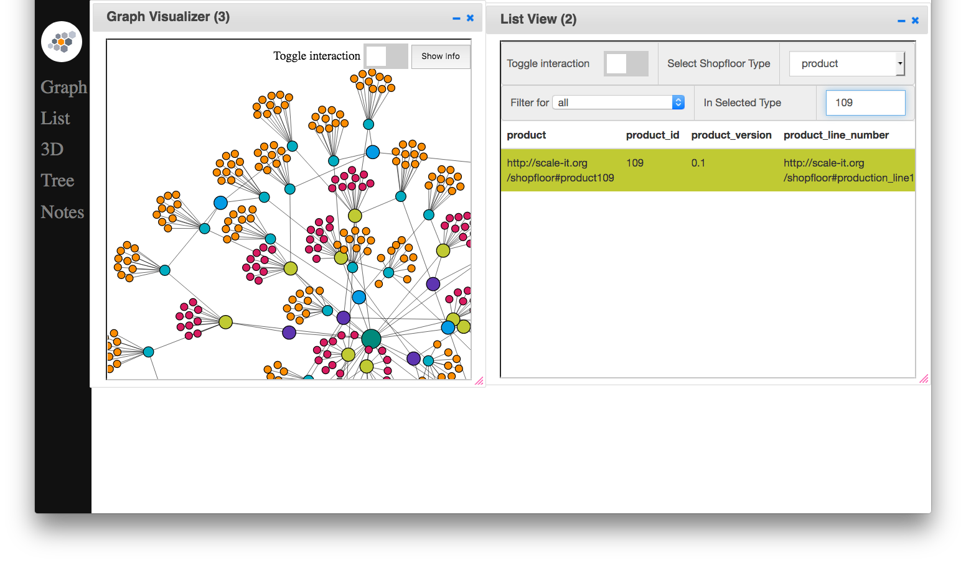
4. Search for Product with Id 109 in List View App

Slide 13
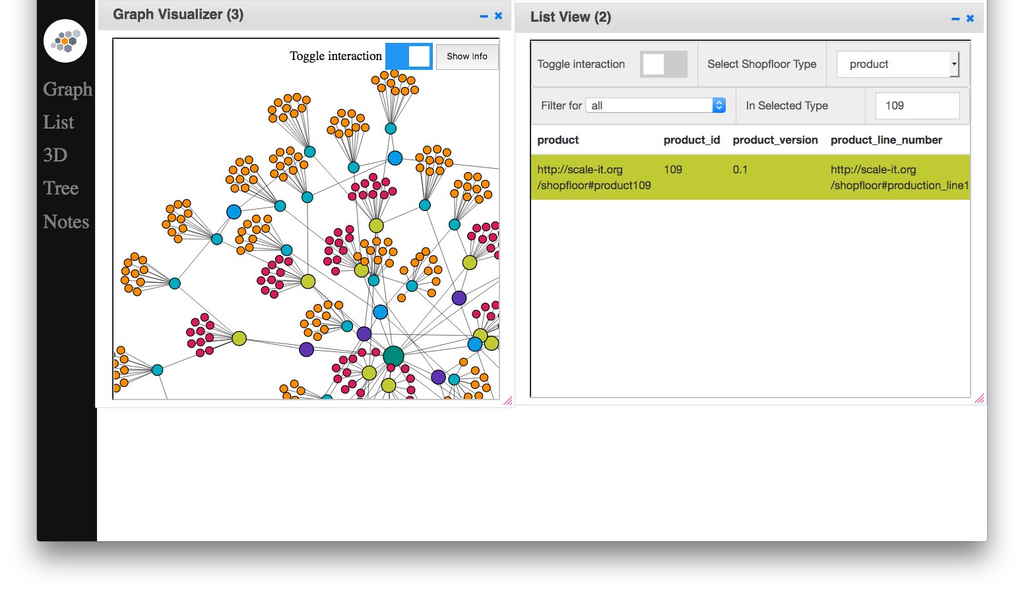
5. Enable User Context in Graph View App

Slide 14
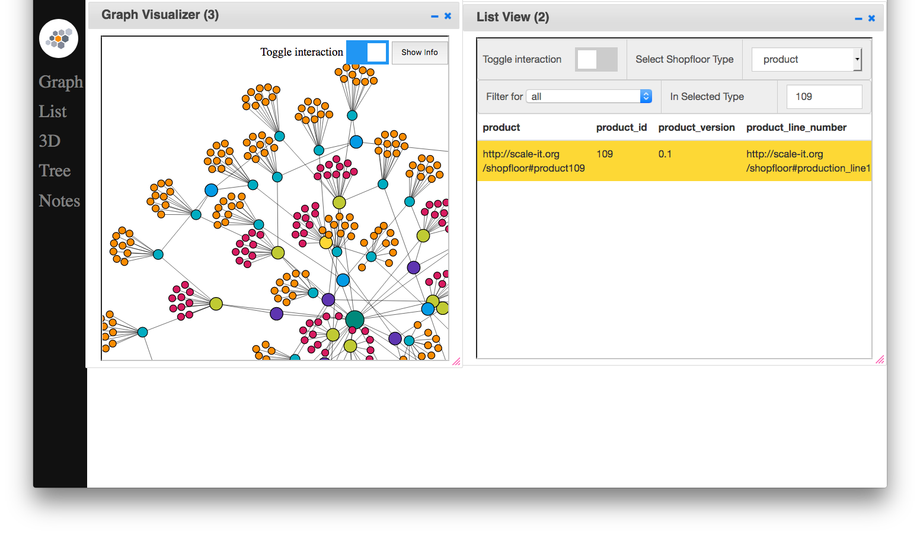
6. Select Product with Id 109 in List View app

Slide 15
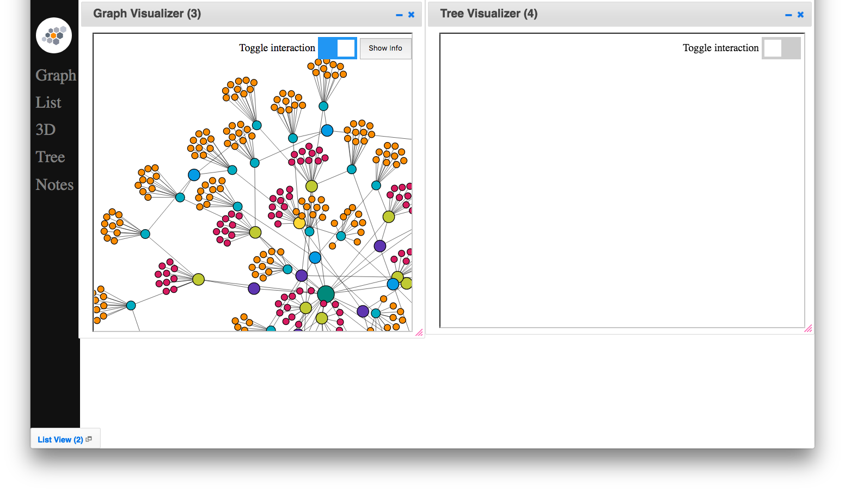
7. Open a Tree View App

Slide 16
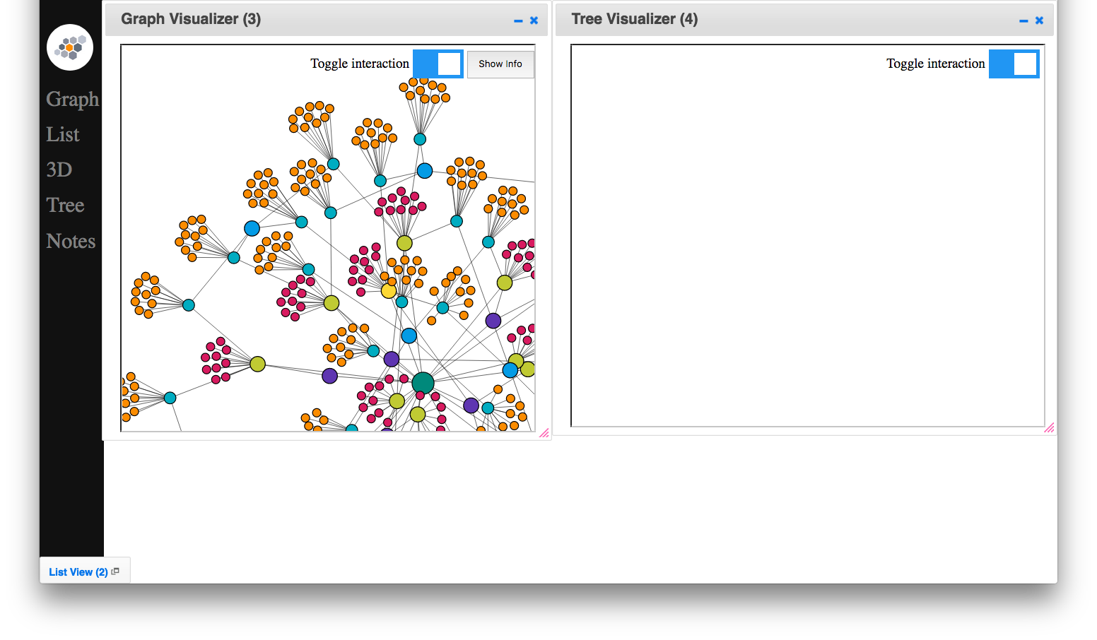
8. Enable User Context in the Tree View App

Slide 17

9. Select an Observation in the Graph View App

Slide 18
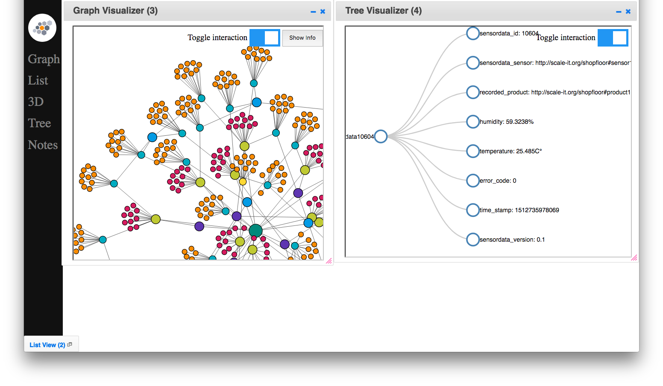
10. Expand Tree View at Root

Slide 19
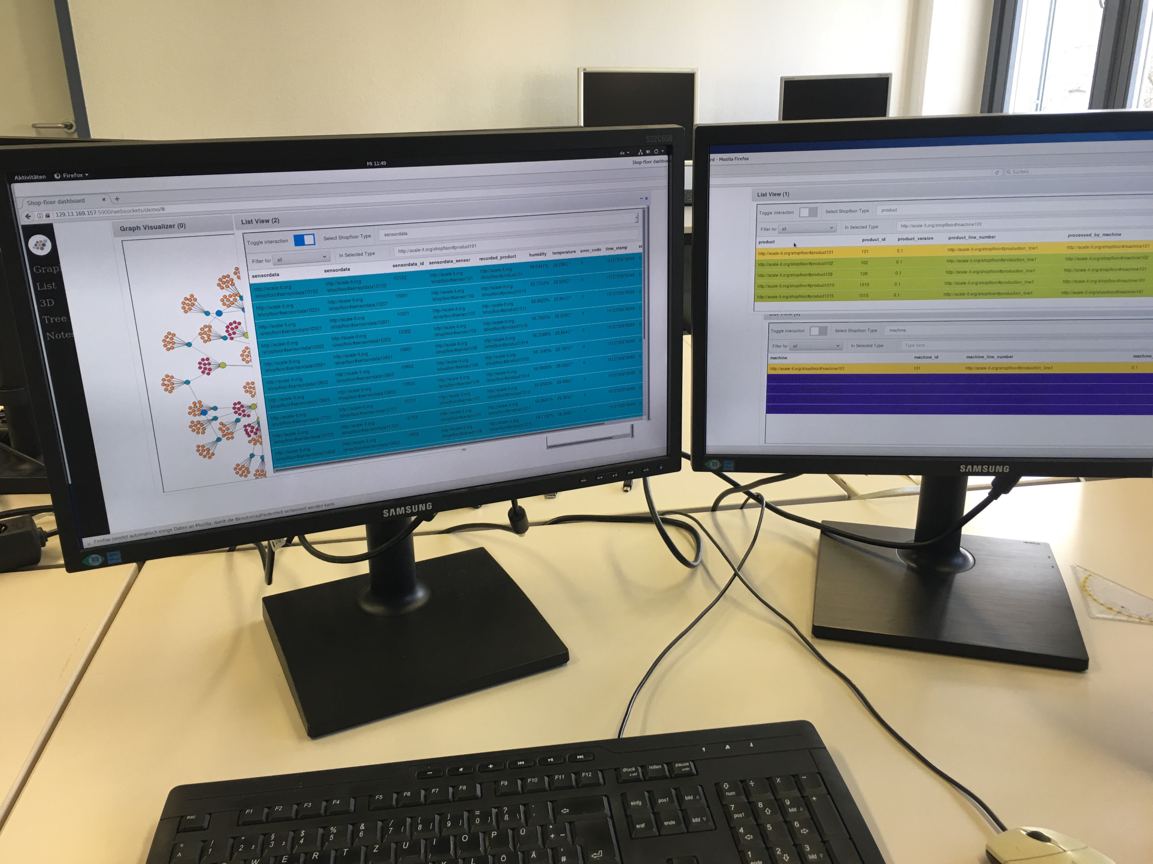
Evaluation - Overview
5 Participants without domain experience
Task T1 as introduction example
Tasks T2-T4 each 5 minutes
Goal: Investigate benefits of graph structure
Compare common operator tasks in effort and speed
User environment of participants
Evaluation tasks
Matthias Schedel - Shop-Floor Linked Data Graph

Slide 20
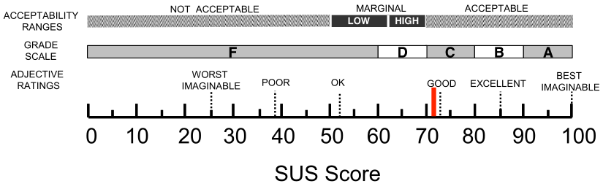
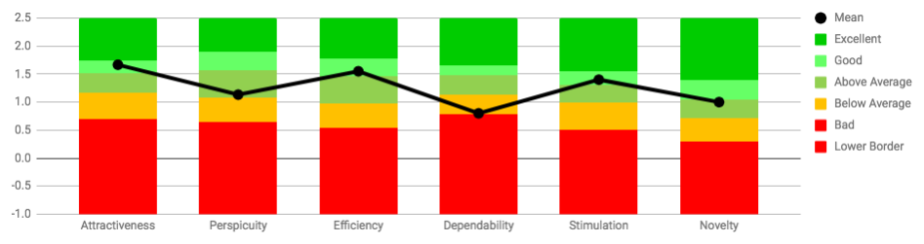
Evaluation – Results SUS and UEQ
SUS score: 72
Highest: 85
Lowest: 54
SUS results of study – scale created by Kortum at al.
UEQ:
Highest scale: Attractiveness with 1.666
Lowest: Dependability with 0.8
UEQ results of study compared with 247 other studies
Matthias Schedel - Shop-Floor Linked Data Graph

Slide 21
Evaluation – Results Custom Questions
2 Questions with selected answers

Slide 22
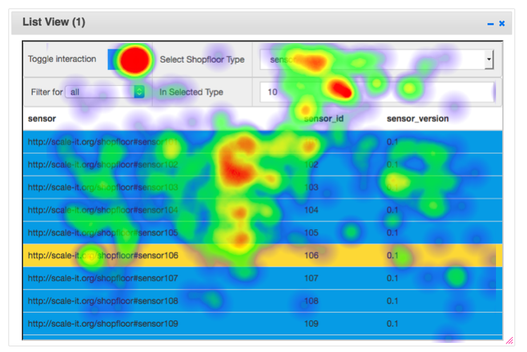
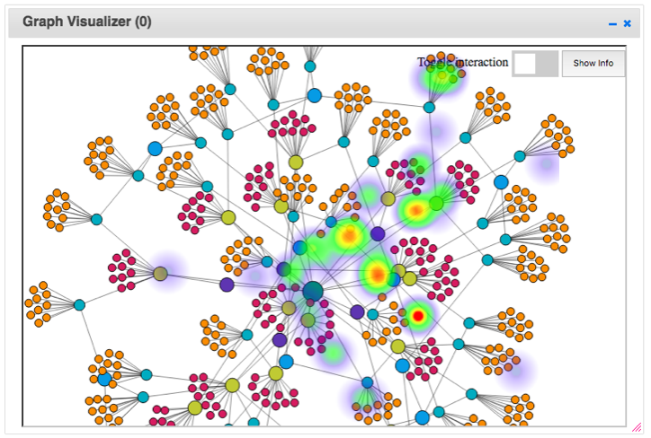
Evaluation Results - Heatmaps
Recorded for each evaluation session
Click and Hover actions
List View App with overlaid heatmap of mouse clicks
List View App with overlaid heatmap of mouse clicks
Graph View App with overlaid heatmap of mouse clicks

Slide 23
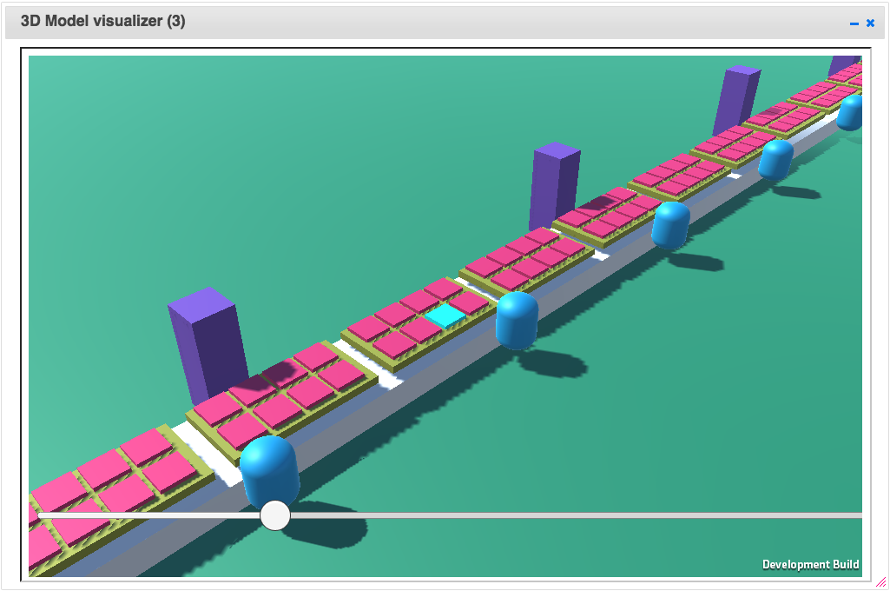
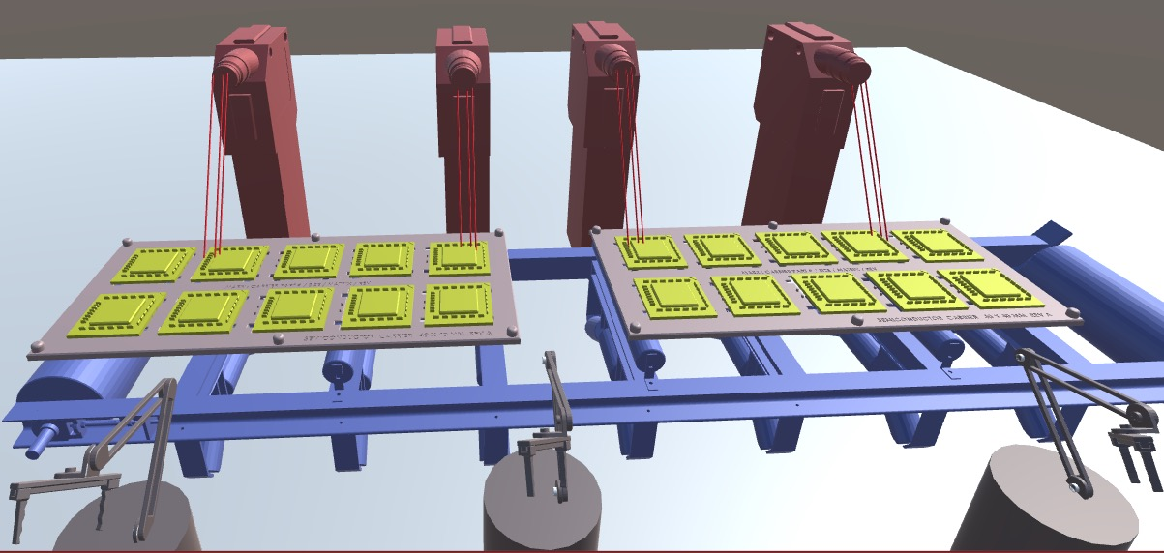
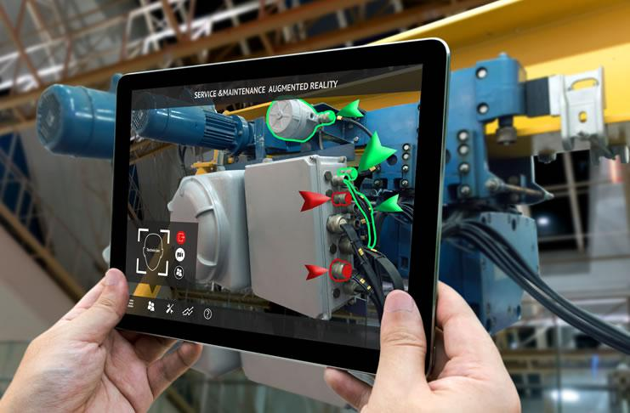
Outlook
3D model view App
Already developed
Augmented Reality App
Planned
3D model view app
Example for augmented reality app
Notes:
http://www.codemconsultancy.com/wp-content/uploads/2017/10/prevent-errors.jpg

Slide 24
Conclusion
2 major challenges addressed
Accessibility and acquisition of sensor data
Availability and readability of entity relationships
Evaluation
UEQ and SUS state good usability
Graph-structure can improve understanding
Matthias Schedel - Shop-Floor Linked Data Graph
Notes:
The architecture design of the system addresses two major challenges on the shop floor. First, the acquisition and access of sensor data and machine meta-data on the shop floor and second, the availability and readability of information about relationships between IIoT devices.
To master these challenges a proof-of-concept architecture has been developed. The goal of the architecture is to acquire shop floor data, process it to generate Linked Data and expose it in a way that makes it accessible and readable for different parties on the shop floor. The design of the architecture is based on a distributed micro-services architecture combined with Linked Data and IoT principles like decentralization, digital twins and device inter-connectivity. The architecture is deployed with acontainerized infrastructure.
To provide a more generic solution that can be adapted to different scenarios with different data and data storage types the Linked Data adapter design pattern has been used. This pattern allows to create a system of decoupled apps, each individually replaceable to adapt to current needs of the scenario without changing other services, that perform the task of Linked Data generation.

Slide 25
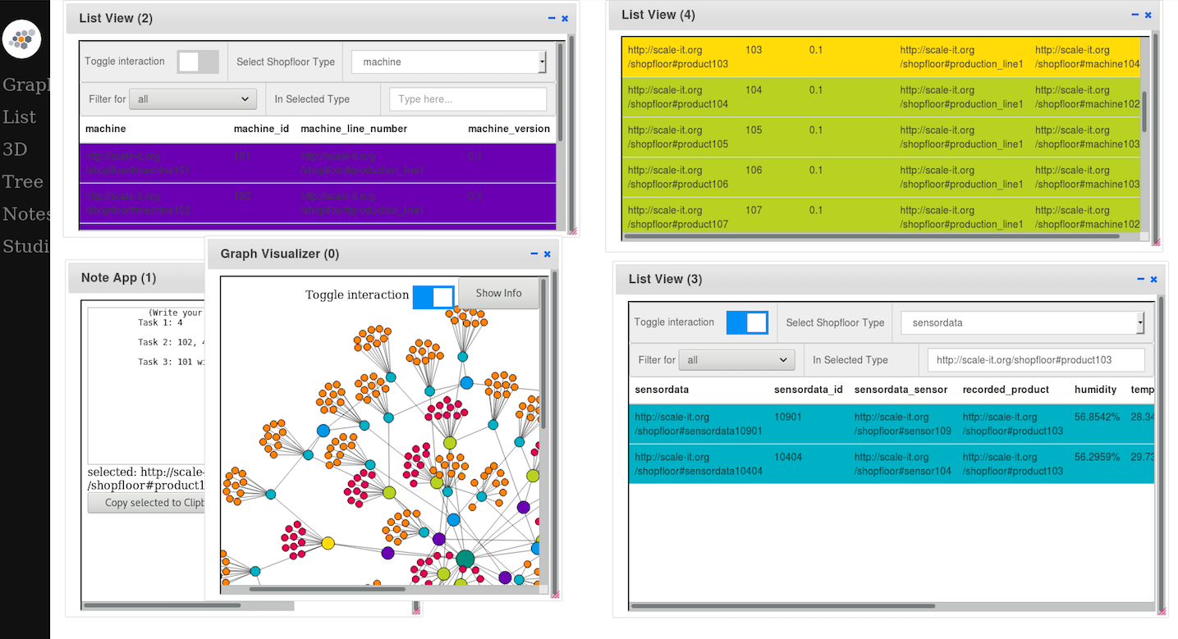
Implementation - User Dashboard (Backup)
Dashboard
AppStore principle
Customizable
Matthias Schedel - Shop-Floor Linked Data Graph
Notes:
Improvements for App Dashboard:
Config options under apps input form for x, y values
(2) Important features
- each app runs in its own container
-

Slide 26
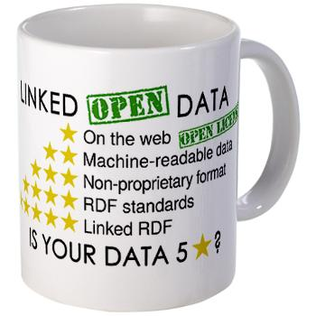
Design - Building Blocks (Backup)
HTTP + REST
Event-driven messaging
Ontologies
JSON-LD (Frames)
Linked Data principles
Linked Data principles
Matthias Schedel - Shop-Floor Linked Data Graph

Slide 27
Implementation - Technology Stack (Backup)
Frameworks
.NET + Nancy, OWIN and …
Jena for Linked Data operations
Node.Js + D3.Js
RDF Triple Store: Apache Jena Fuseki (Replaceable)
Communication: HTTP + Rest using Event Collaboration
Deployment: Docker
Matthias Schedel - Shop-Floor Linked Data Graph

Slide 28
3D Model View App (Backup)
Not used in evaluation
Notes:
http://www.codemconsultancy.com/wp-content/uploads/2017/10/prevent-errors.jpg

Slide 29
What is Linked Data (Backup)
Set of technical and conceptual best practices
Creating data
Publishing data
Connecting data on the web
Principles can be applied to the manufacturing domain to create a resource description framework (RDF) for IIoT devices.
RDF
Use URIs to name relationships between objects and the objects themselves (triple).
Allows to share structured data between different applications.
Matthias Schedel - Shop-Floor Linked Data Graph

Slide 30
Related Work (Back up)
Graube, M., Ziegler, J., Urbas, L., & Hladik, J. (2013). Linked data as enabler for mobile applications for complex tasks in industrial settings. IEEE International Conference on Emerging Technologies and Factory Automation, ETFA. https://doi.org/10.1109/ETFA.2013.6647948
Pahl, C., Helmer, S., Miori, L., Sanin, J., & Lee, B. (2016). A container-based edge cloud PaaS architecture based on raspberry Pi clusters. Proceedings - 2016 4th International Conference on Future Internet of Things and Cloud Workshops, W-FiCloud 2016, 117–124. https://doi.org/10.1109/W-FiCloud.2016.36

Slide 31
Design – Requirements (Backup)
3 Components: Semantic, Storage and App-Dashboard
R and System:
Semantic
Apply ontology mapping to incoming data
R: Input kann abweichen -
Storage
Storage Client for Graph-Database
R: Allow operations + Graph-DB independent
App-Dashboard
Orchestration of specialized apps that perform user task individually or together in complex work flow
example 1) Graph Visualization
example 2) 3D-Model Visualization of Shop-floor
R: User-Context aware
Visualization Apps
Matthias Schedel - Shop-Floor Linked Data Graph
Notes:
(1) ScaleIT Plattform einbauen

Slide 32


Linked Data Technologies (Backup)
RDF, OWL
SPARQL, JSON-LD
Fuseki/Jena
Linked Data technologies
Matthias Schedel - Shop-Floor Linked Data Graph
Notes:
Images sources:
https://json-ld.org/images/
https://www.w3.org/RDF/icons/
https://www.w3.org/DesignIssues/LinkedData.html
https://www.quora.com/topic/SPARQL
http://www.canertosuner.com/post/nancy-nedir-nancyfx

Slide 33
Backup

Slide 35
Implemtation: Visualization Dashboard
2. Open List View

Slide 36
Evaluation – Results UEQ
UEQ:
Highest scale: Attractiveness with 1.666
Lowest: Dependability with 0.8
UEQ results of study compared with 247 other studies
Matthias Schedel - Shop-Floor Linked Data Graph

Slide 37
Prevent creation of data islands - Raw sensor data acquisition and Linked Data generation
Use of Linked Data adapters
Extendable and replace data interfaces

Slide 38


Dataflow chain part one
Linked Data Acquisition
Linked Data Storage
NFC Sensor
Raw sensor data
Storage App
Phone
Semantic App
Linked Data

Slide 39
Raw sensor data
Parsed sensor data
Sensor Linked Data

Slide 40
Scenario
Product line
Product
Shop floor system
scans
Sensor
raw data
Linked Data visualization
Product
User
Shop floor system:
Transform to Linked Data
Store & provide Linked Data
Visualize Linked Data
Linked Data
Linked Data

Slide 41
Dataflow Chain Part two
Linked Data Storage
Dashboard and Visualization Apps:
RDF
triple
store
SPARQL client

Slide 42
Visualization Apps
Storage App
UI

Slide 43
Evaluation Results - Heatmaps
List View App with overlaid heatmap of mouse clicks
Graph View App with overlaid heatmap of mouse clicks

Slide 44
(Later removed) Presentation Structure
Background
Evaluation use case (screen recording gif)
Motivation
Related work
Architecture design
Evaluation
Design
Requirement
Design building blocks - Web + Linked Data Technologies
Workflow breakdown
Four apps
Semantic
Storage
Dashboard
Visualisation apps
Implementation
Screenshot before and after
Technology Stack
Deployment Architecture
Evaluation
Study design (scope, design, goal)
Study overview (Participants, how it went)
Results (Graphs)
Summary (conclusion, future work, insights, …)
Matthias Schedel - Shop-Floor Linked Data Graph

